Slide 1
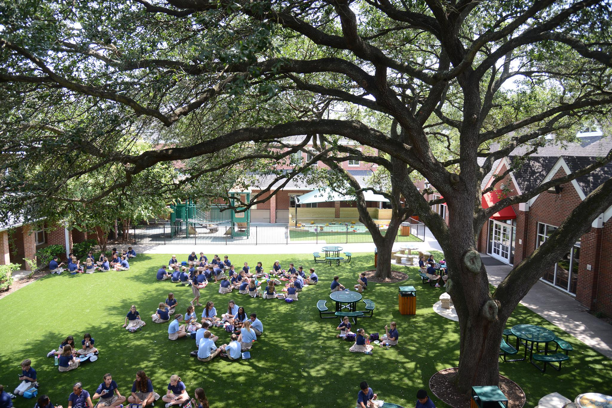
St. Mark's Episcopal School
A Demographic Study

Slide 2
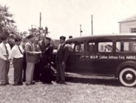
Historical Background
West University Place is surrounded by the cities of Bellaire, Houston, and Southside Place. The U.S. Postal Service uses "Houston" as the city designation for all West University Place addresses, although the actual name of "West University Place" is also acceptable.
As of 2011, West University Place is the 5th highest fraction of households with incomes $150,000 or greater.
Almost all street names in West University Place are allusions to universities, colleges, and poets throughout the United States and the world.

Slide 3
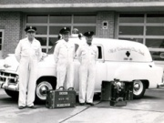
Historical Background
St. Mark's Episcopal Church and School:
1939: Church founded
1960: mother’s-day-out created
Evolution: preschool > elementary > middle school
1988: first 8th grade class graduates
1990: Southwestern Association of Episcopal Schools
2010: 50 year anniversary!

Slide 4
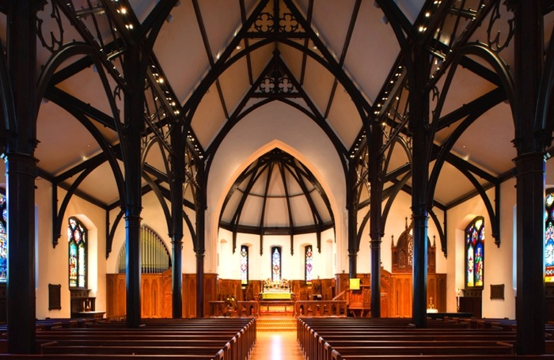
Why St. Mark's?
"The Evangelist"
Founded Christian church in Egypt; jailed; martyred
Visited by an angel in the form of a lion and this is now St. Mark's symbol
Mark's gospel tells the story of Jesus according to Peter; first written after death
"At St. Mark's we want our kids to feel empowered to lead, but also to have the courage and strength to follow."
St. Mark's Day celebrated in chapel April 25

Slide 5
Campus Governance
Rector (priest) charged by the Bishop of the Diocese
executive chairman of the Board of Trustees > defers this to an elected trustee; Rector serves as a voting board member
Board of Trustees: governance of the School; our long term health relies on the Board working with the Church Vestry and the Head of School; Board hires one employee: the Head of School; Board is "self-replicating"
Head of School hires all other employees with option to defer this to Senior Administration team

Slide 6
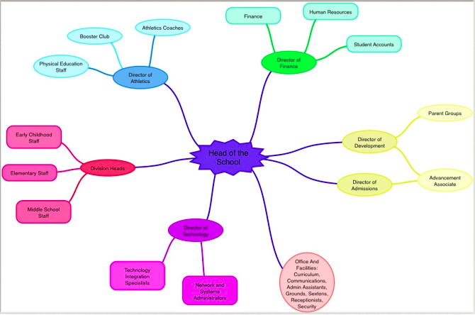
Campus Governance

Slide 7
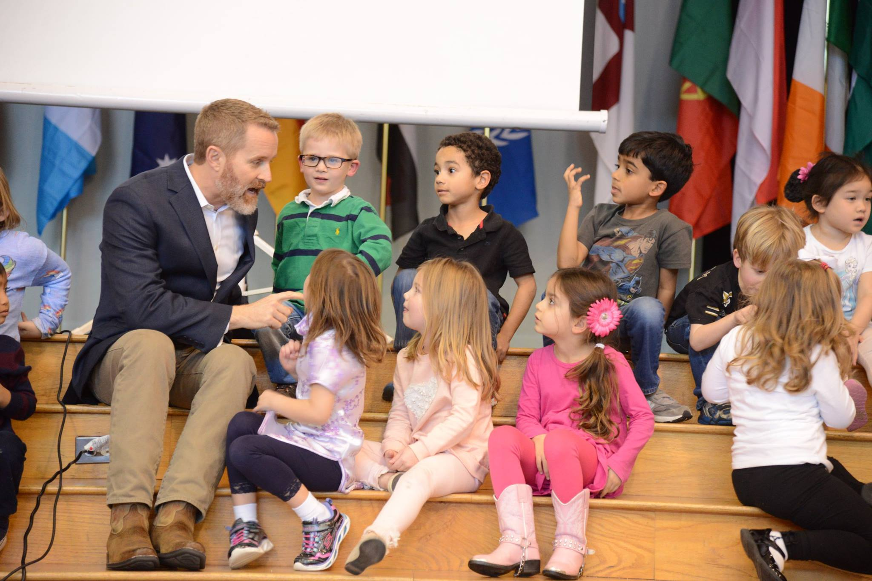
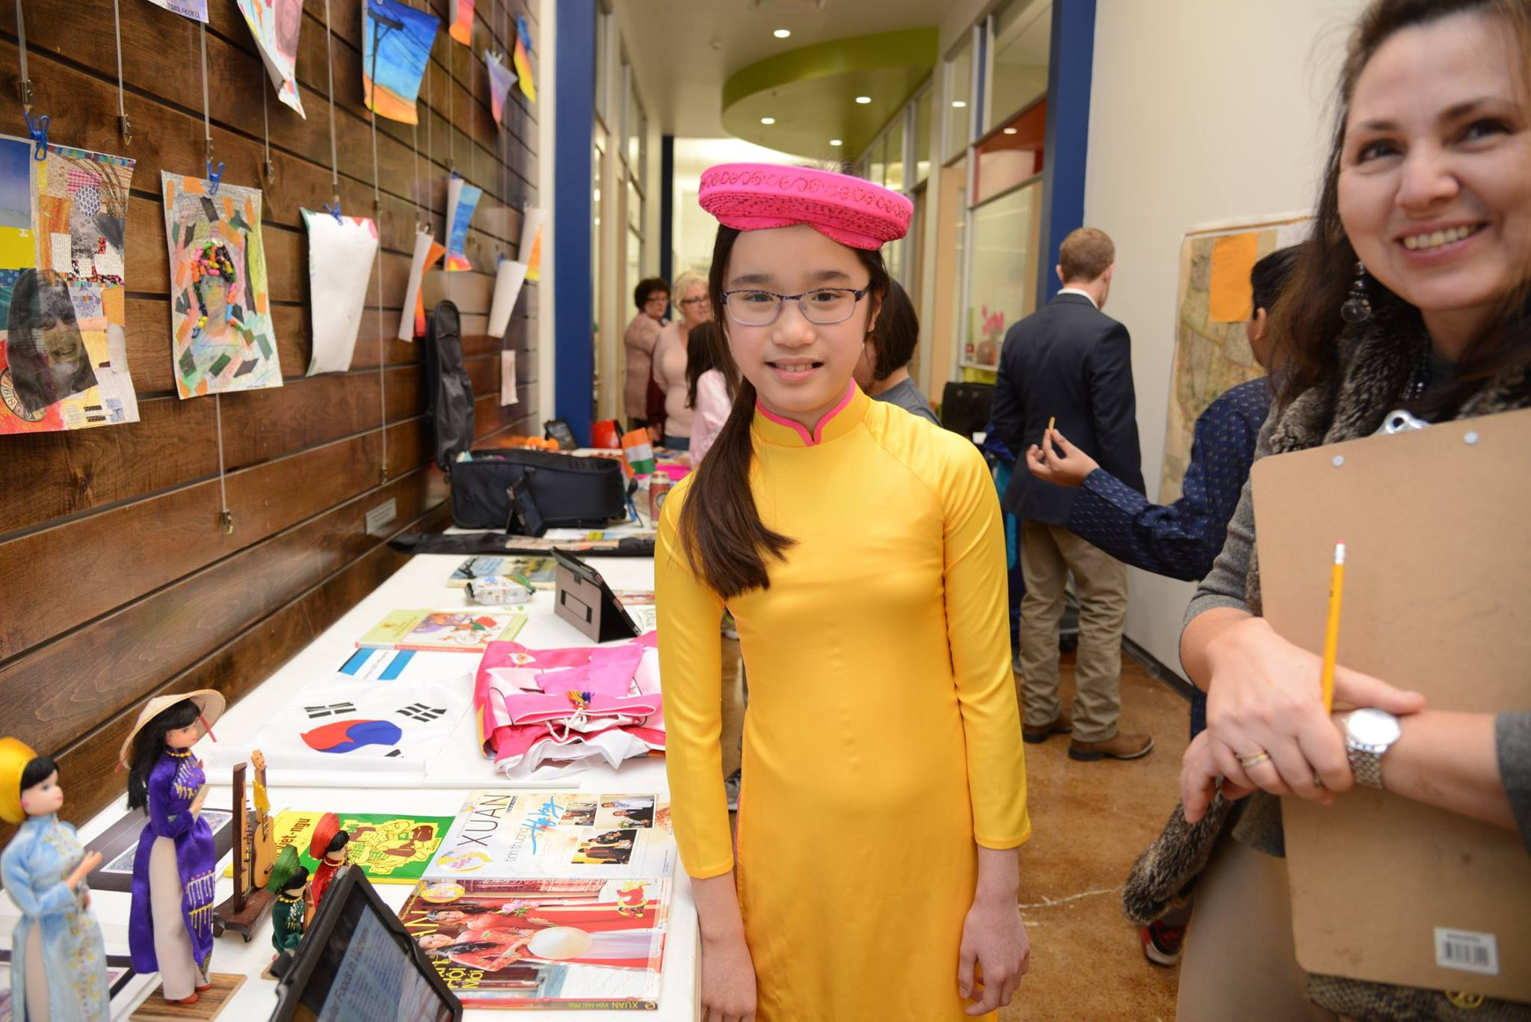
Enrollment, Growth, Achievement
No district level
Enrollment:
Total: 435 students
SES: not available
51% Female; 49% Male
35+ heritages represented
Educational Records Bureau: CTP 4
Strengths: writing skills
Weaknesses: Spanish skills

Slide 8
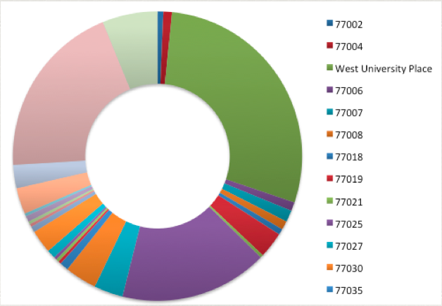
Political and Geographical Characteristics

Slide 9
Family Involvement
Parent Guild: support the school through events and programs, self-supporting organization
Parent Guild Committees: www.stmes.org/page.cfm?p=672
Booster Club: Parent Volunteers; Director of Athletics; fundraising

Slide 10
Professional Staff
All lead teachers must be certified and have at least a Bachelor's degree
All assistants in Kindergarten up must be certified and have at least a Bachelor's degree
All Senior Administrators must have prior teaching experience and at least a Master's degree

Slide 11
The St. Mark's Mission The community of St. Mark’s Episcopal School celebrates the uniqueness of each child. We are stewards of our students’ intellectual curiosity, faith, and passion for discovery. We cultivate joy, playfulness, and growth in a child-centered environment.
http://www.stmes.org/cf_media/index.cfm?obj=16563

Slide 12
