Slide 1
Response to Intervention
By: Lynden Haley
EDSP 5319

Slide 2
Response to Intervention
In 2004 the face of special education was dramatically changed when the discrepancy model was replaced with Response to Intervention, a model that helped identify special education students with early intervention.
RTI is a method of helping struggling learners by providing intervention early on.
In contrast to the discrepancy model, RTI does not wait for a student to fail before identifying their learning differences, teachers begin intervening before a student gets irreparably behind.

Slide 3
Tiers
The RTI model is a tiered system wherein the teacher is the first to identify a problem and begins by implementing in class interventions while maintaining communication about progress with a student’s parents and special education staff.
In tier 2 students are given specified interventions in the general education classroom. Students are still included in regular education classes, but they are given more one on one help from their teachers and their progress is closely monitored.
In tier 3 testing is administered and students are moved to a special education class or labeled with their learning disability and then provided official accommodations.

Slide 4
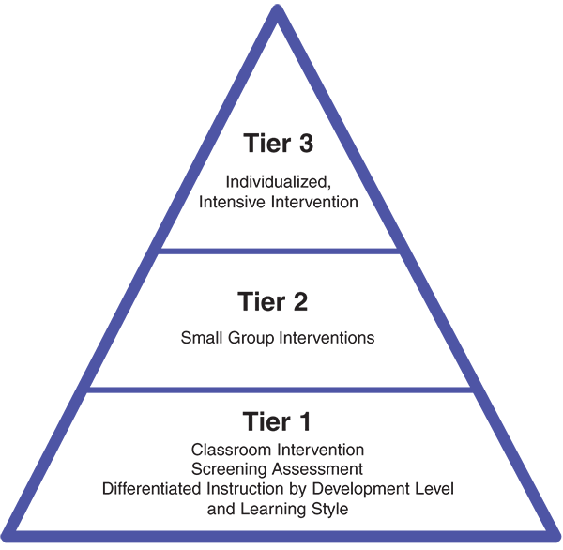
Tiers

Slide 5
Why RTI?
RTI is a model that allows students to receive additional support, whether they are labeled with a specific disability or not.
The RTI model has leveled the educational playing field by allowing all students to receive additional help whenever they need it.
If intervention can be practiced early with a child, errors can be prevented from the start and students have a greater chance of success.

